Slide 1
Event Management System
Nicholas Cessna & Zhiyong Zhang
Dec 9, 2024

Slide 2
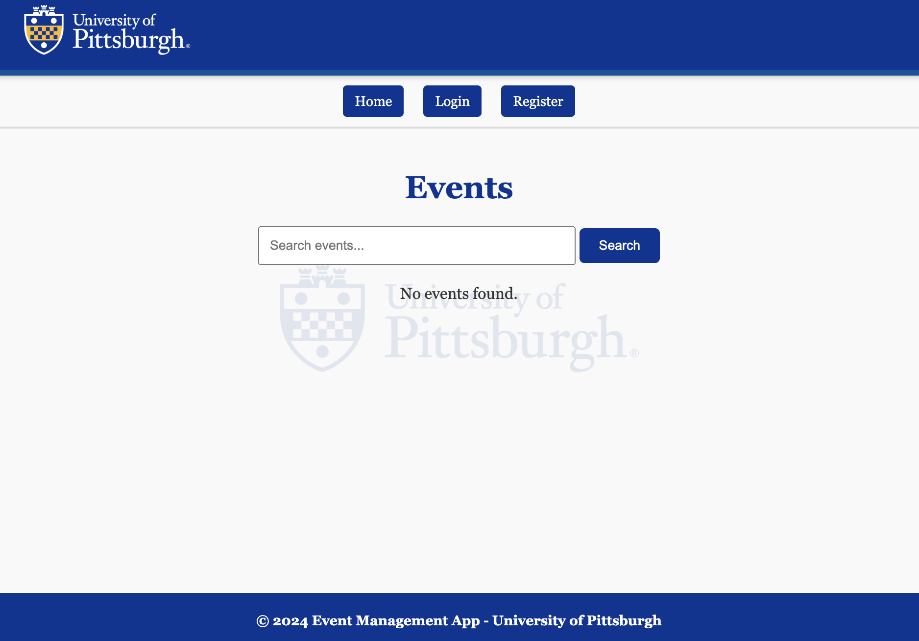
Project Overview
Details:
A central platform for organizing campus events through a web interface.
Address user needs:
Students and Staff: Browse and sign up for events easily.
Event Organizers: Efficiently create and manage events.
Built with scalability, usability, and security in mind.

Slide 3
Implemented Requirements:
Requirements Promised in the Design Document:
Landing Page: List events with title, time, location, and type by date.
Search Function: Search upcoming events by keywords or tags.
Event Details: Display title, type, tags, organizer, time, location, images, and description.
User Accounts: Register/login, sign up or cancel events, and view attendee counts.
User Profile: View upcoming/past events, update profile settings.
Event Manager Accounts: Publish/edit/cancel events, manage organizer-specific events.
Manager Profile: List managed events, access past events, create/edit/cancel events, view registrants.
Event Archiving: Archived past events are immutable and non-signup-able.
Base Requirements Fulfilled:
All promised requirements have been implemented.
Additional Features Fulfilled (Not Promised in the Design Document):
Persistent storage with a properly configured database using SQLAlchemy.
Map with event information location.
The system provide platforms other than web for user to interface. Android Application APK.

Slide 4
System Architecture & Functionality:
Event Features:
Dynamic listing with search and pagination.
Signup/un-signup functionality.
User Features:
Profile management: Update information, change password.
Role-based UI options.
Event Publisher Features:
Add, edit, and delete events.
Upload event images.
Database Features:
Relational design with User, Event, and SignUp models.
CRUD operations for all models.
MVC Architecture:
Model: Handles database interactions via SQLAlchemy & SQLite.
View: Generates web pages dynamically with Jinja2 templates.
Controller: Implements logic to process user requests and responses.

Slide 5
Program Demo

Slide 6
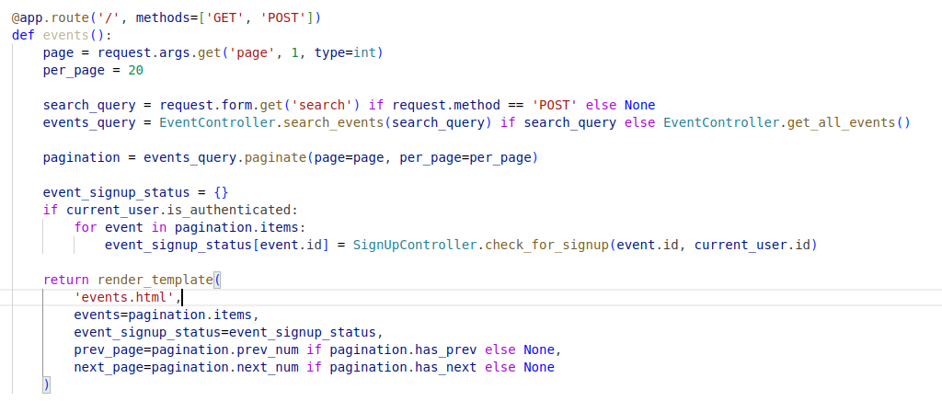


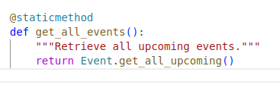
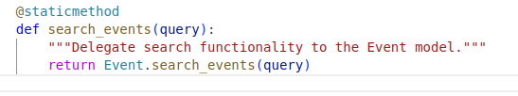
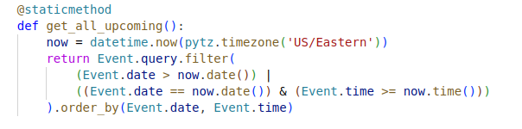
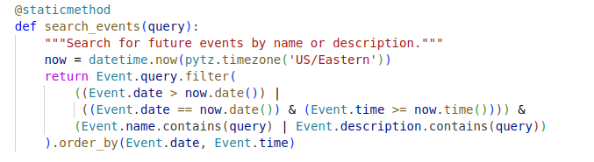
Event Viewing
Requirements Fulfilled:
Base Requirement 1: Landing page showing a list of events with previews (title, time, location, type).
Base Requirement 2: The system will provide a search function for upcoming events using either keywords or tags.
Base Requirement 3: View event details, including title, type, tags, organizer, time, location, preview image, and description.
Base Requirement 8: All the past events should be considered archived, and no changes and signups are allowed to these past events.
Purpose: Fetches and displays all events or search results.
Showing all Upcoming
Search Events
Purpose: Handles logic for retrieving all upcoming events or filtering by a search query.
Purpose: Fetches upcoming events from the database and performs search filtering.

Slide 7
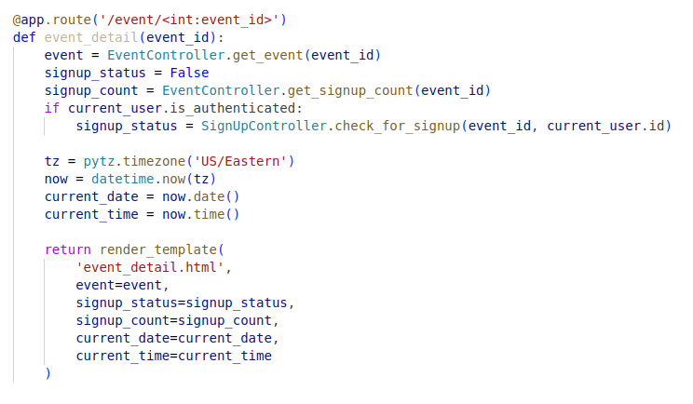
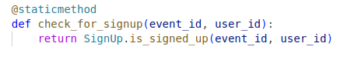
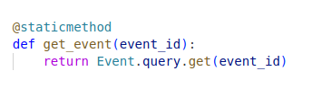
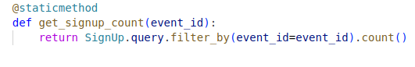
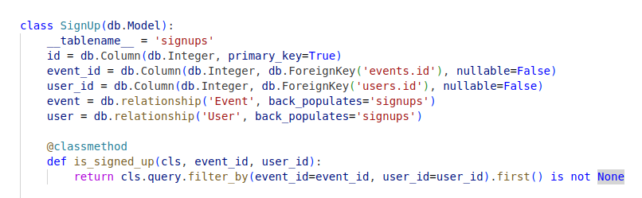
Event Details
Requirements Fulfilled:
Base Requirement 3: The system should allow all types of users to view the details of each event, which include the event’s title, type, tags, organizer, time, location, preview images (i.e. posters, speaker photo, etc.) and the description for the event.
Requirements Fulfilled:
Base Requirement 1: Landing page showing a list of events with previews (title, time, location, type).
Base Requirement 2: The system will provide a search function for upcoming events using either keywords or tags.
Base Requirement 3: View event details, including title, type, tags, organizer, time, location, preview image, and description.
Base Requirement 8: All the past events should be considered archived, and no changes and signups are allowed to these past events.

Slide 8
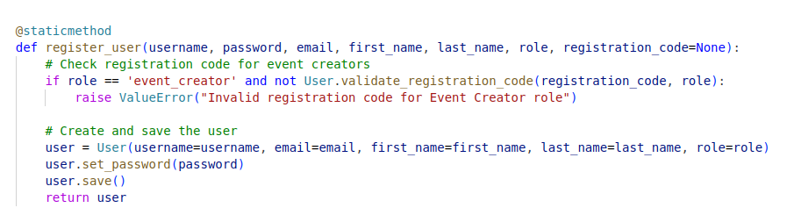
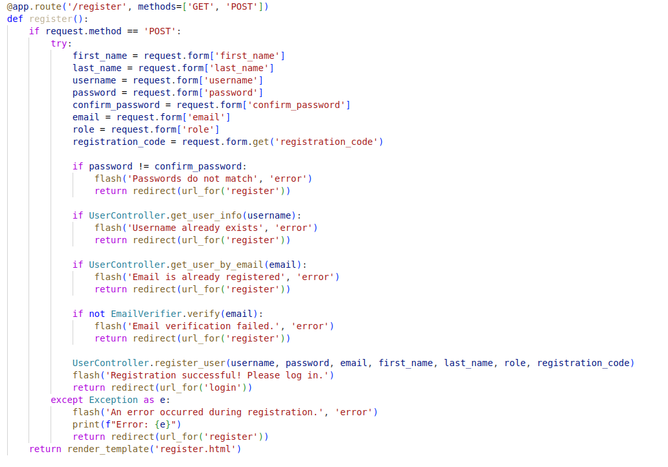
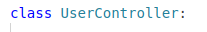
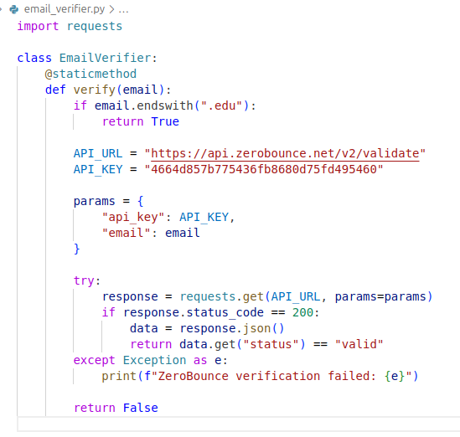
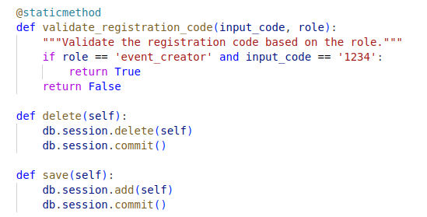
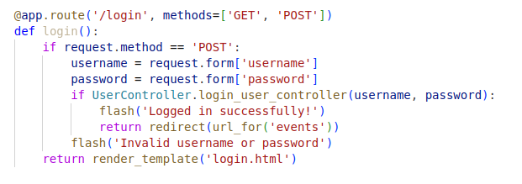
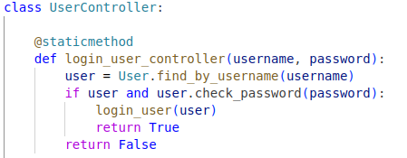
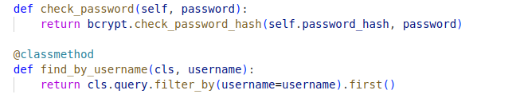
User Registration & Login
Base Requirement 4: The system will provide user registration and login portal with username/email address and password.
Base Requirement 6:The system will also provide a type of account for event managers. The manager accounts are tied to specific event organizers.
Register:
Login:

Slide 9
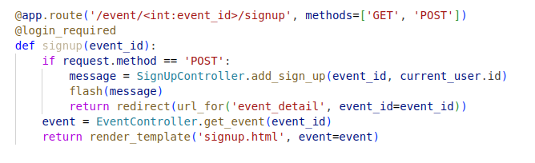
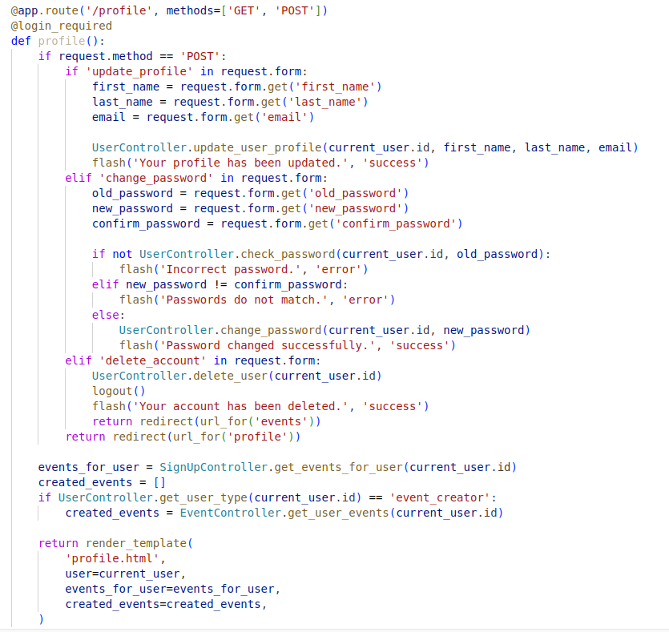
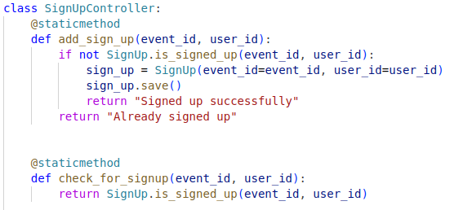
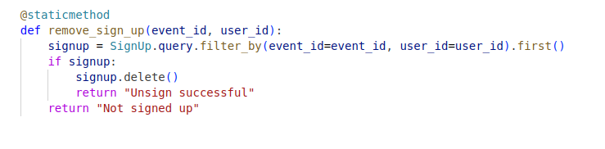
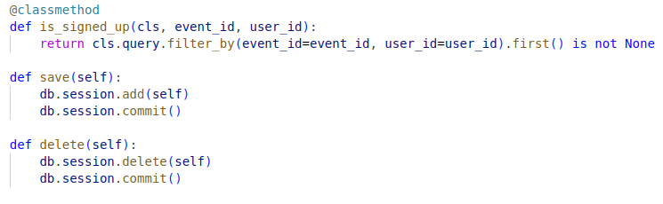
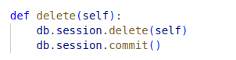
Event Signup & Un-sign
Base Requirement 4: Registered users can sign up for future events, cancel the signups before event start, and view the number of registered users signed up.
Signup:
Un-sign:

Slide 10
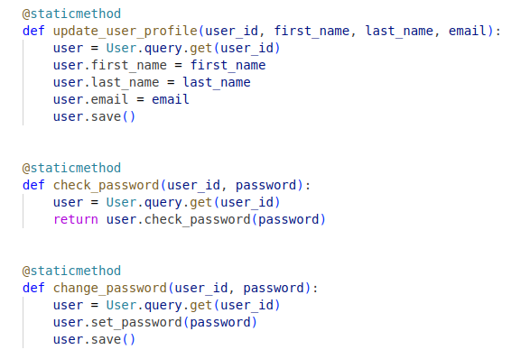
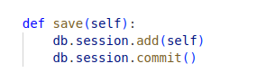
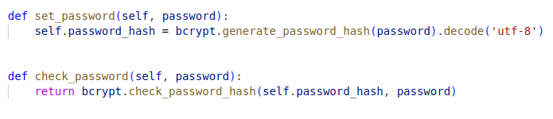
Profile Mangement / User Settings
Change name, email, password & Event signups and/or managed list.
Base Requirement 7: The profile page of the event managers accounts will display the list of events they are currently managing. a link to the list of past events that the account has managed, and a link to create new events. there are options for the manager account to edit the event information or cancel the event. The event manager can also see the list of registered users that have signed up for the specific event.
Base Requirement 8: All the past events should be considered archived, and no changes and signups are allowed to these past events.
Base Requirement 5: The system will provide the registered user a user profile page and settings page. The profile page will show the list of upcoming events with a preview that the user has signed up for, and a list of passing events that the user has signed up for, with additional useful information. The settings page will allow the registered user to view and change their username, login information, etc.

Slide 11
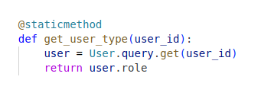
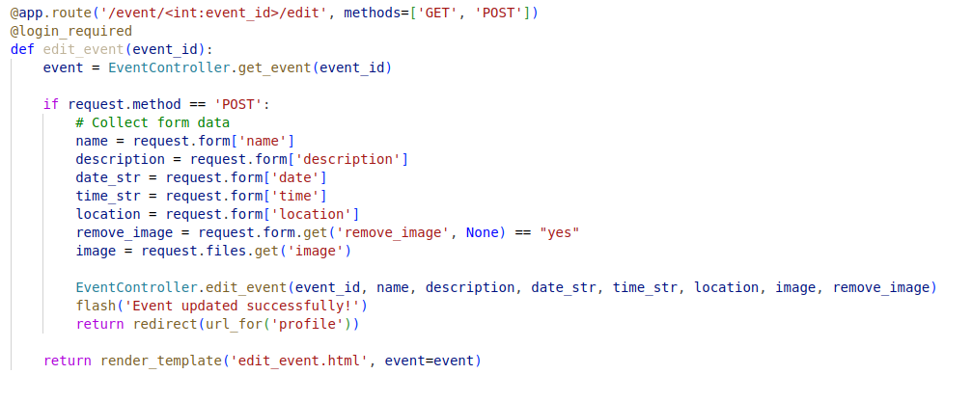
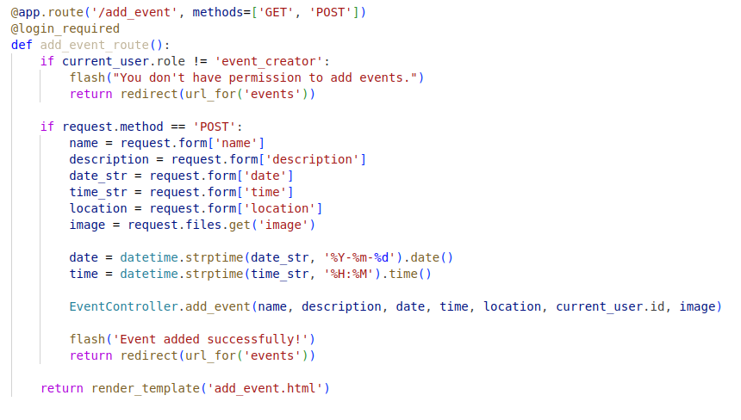
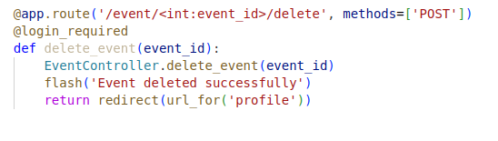
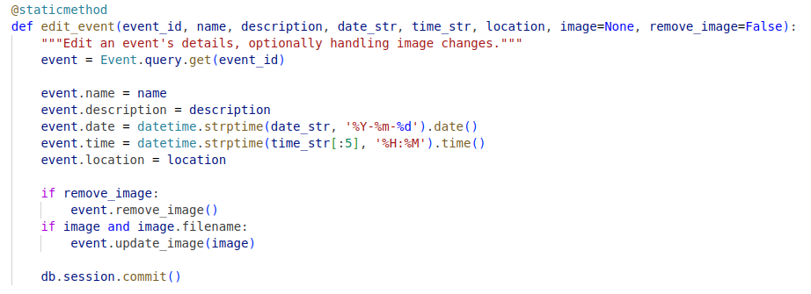
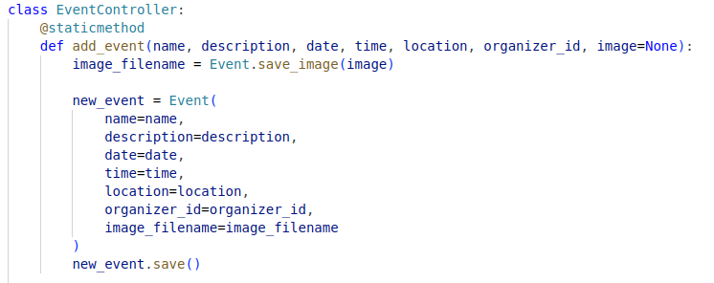
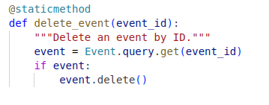
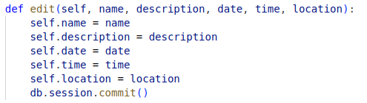
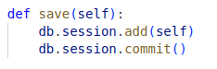
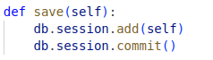
Managing Event`s
Base Requirement 7: The profile page of the event managers accounts will display the list of events they are currently managing. a link to the list of past events that the account has managed, and a link to create new events. there are options for the manager account to edit the event information or cancel the event. The event manager can also see the list of registered users that have signed up for the specific event.
Creating:
Editing:
Delete:

Slide 12
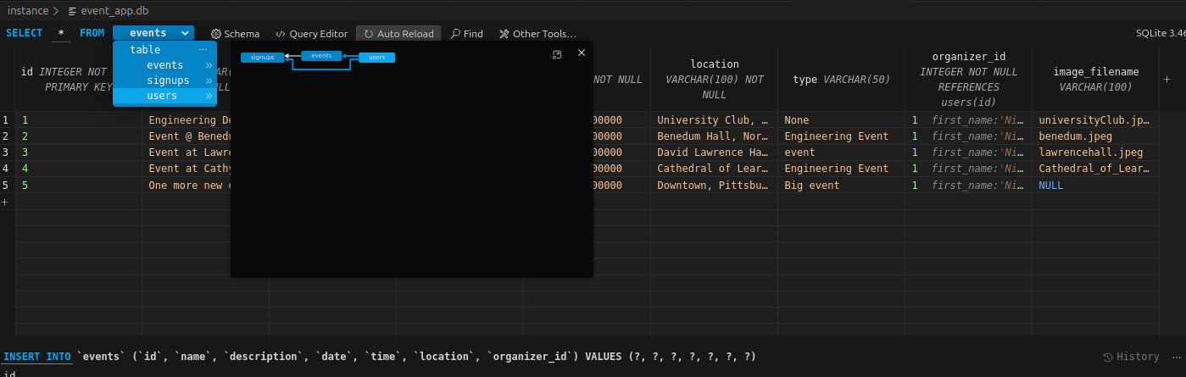
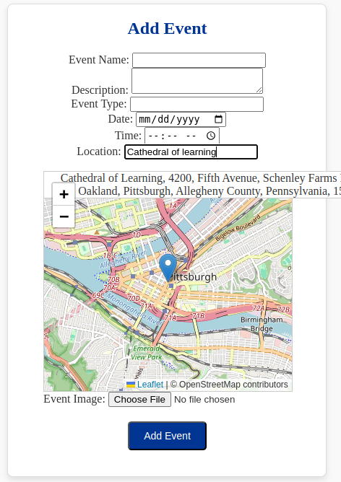
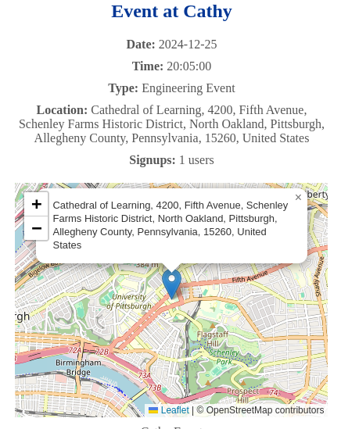
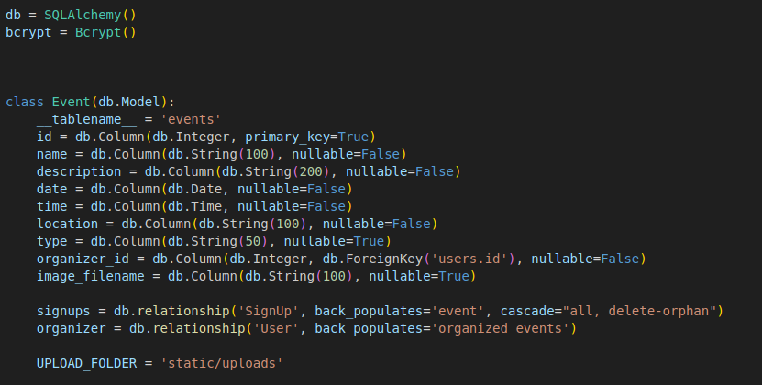
Advanced Requirements:
Advanced Requirement 1: System Uses SQLAlchemy & SQLite with flask_migrate for a persistent databasing.
Advanced Requirement 4: Event creation and event details incorperates a location map and address auto suggest using OpenStreetMap API.

Slide 13
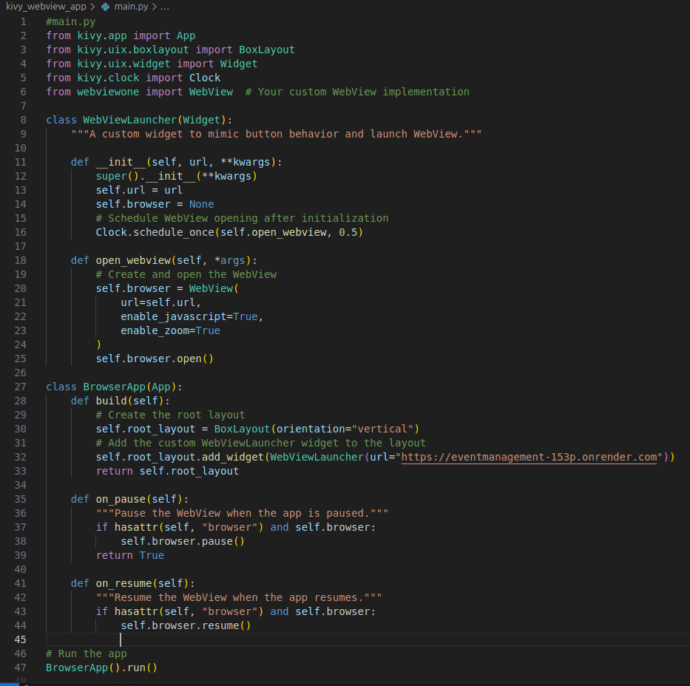
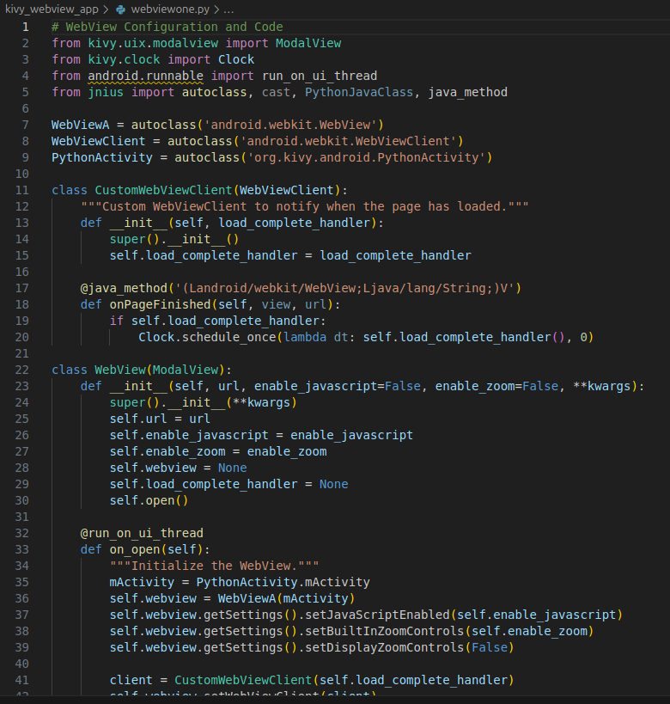
Advanced Requirements:
Advanced Requirement 2: Created Mobile Android App Using Kivy & Web View to build and installable APK.
Published Flask App on OnRender
Created virtual environment to hold Kivy and WebView packages and dependencies
Set the Kivy application to render my OnRender URL via Jnius/WebView
Built Android APK using Buildozer and Python-for-Android
Worked enhance mobile format of webview display.

Slide 14
END
-Thank you to Professor Keyang Zheng for an informative semester.

